Slide 1
ECC and the evolving spectrum policy
Eric Fournier
Chairman, Electronic Communications Committe
Conference on spectrum management: perspectives, challenges and strategies
Lisbon, 20 September 2013

Slide 2
Who are the spectrum managers?
Global – ITU Radio Regulations : Treaty between member states
To avoid harmful interference to stations operated by other administrations
ITU-R Recommendations and report = caracteristics of equipment and standards (IMT, Broadcasting, maritime), sharing studies ...
‘European’ – ETSI – CEPT/ECC – European Union : harmonisation and single market
Harmonised conditions to use spectrum and equipment/system standards;
CEPT/ECC : designation of spectrum for applications - ‘soft harmonisation’ – in ECC Decision. ECC recommendations/reports provide additional harmonisation measures and technical studies
EU – binding harmonising regulations in accordance with the EU ”spectrum decision”(676/2002/EC), single market
National frequency regulator (NRA)
Issuing authorization including conditions to use spectrum
Regulation

Slide 3
Spectrum management in Europe: 3 institutions
Council
Parliament

Slide 4
Process for harmonising spectrum in EU
Spectrum Policy (2)
Strategy
RSPP
Radio Spectrum Policy Program EU DEC 243/2012/UE
RSPG Opinions and Reports
Technical Conditions (3)
Harmonisation
RSPG
EC mandates
EC Decisions
CEPT reports
CEPT
Commission
Spectrum Decision
Industry
RSCOM

Slide 5
ECC Role in Europe
Based on high technical expertise and longstanding experience in spectrum management ECC works on the basis of consensus and its decisions have a voluntary character. It is a flexible instrument in the hands of national administrations
European Common Allocation Table
Database on the spectrum use by each CEPT member : www.efis.dk
ECC Decisions, Recommendations or Reports
Strong relationship with ETSI and open participation of industry and all stakeholders in the decision making process
European common positions in international conference (ITU World Radio Conference)
Holistic approach of spectrum management : all range of spectrum, all services
Many applications need access to spectrum, from social alarms to satellite, from mobile networks to military radars : ECC has to manage all requests !
Spectrum is a pie to be shared … but there are many ways to share this pie !

Slide 6
Key objectives in spectrum management
Right balance between regulation and flexibility
Too much regulation may prevent innovation
But too “loose” regulation may generate difficult interference case (WiFi 5 GHz to meteo radars, Interference between SRD in the 870 MHz band)
”Neutrality”
Technology neutrality : ”Block Edge Masks”? ”minimum technology performance”?
Service neutrality: designation to ECS, but characteristics are defining networks/applications
Promoting efficient use of spectrum
many regulatory, economic and technical aspects
Promoting harmonisation
Europe first, but manufacturers think ”global”

Slide 7
Need for harmonisation
Lack of harmonisation means:
Equipement cost (economies of scale)
Network cost, e.g. one additional duplexer of 1 dB loss = 10 % capacity loss
Cross-border coordination difficulties
Interference potential
Denial of services
For Europe, obstacle to the single market
Every industry claims for Europe/Global harmonisation
Broadband
Satellite
WiFi
RFID, SRD …

Slide 8
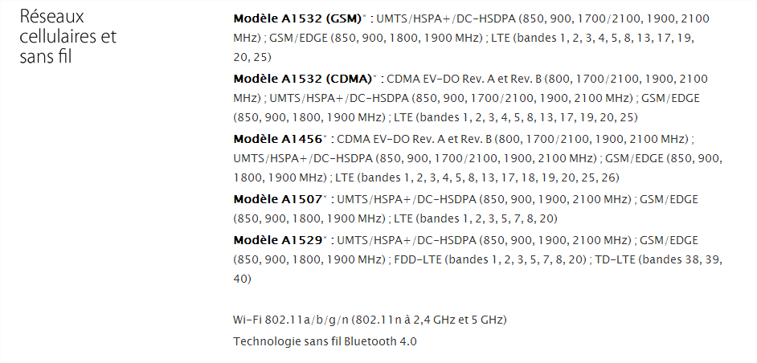
Technology takes care of the lack of harmonisation?

Slide 9
Efficient use of spectrum
There is no absolute metric for evaluating efficient use of spectrum
Depending on criteria (turnover, coverage, social benefit ?) and methodology you may tell that broadcasting is more or less efficient than mobile or that terrestrial is more or less efficient than satellite
Blind measurement of spectrum occupancy leads to false conclusions
Sensitivity of measurement is often based on typical mobile reception
What could make a frequency ”free” is not the absence of measured transmitters, but the absence of close-in receivers
GPS band is empty ? Satellite receiving bands are empty ? Passive service bands are empty ?
But ... Improving spectrum efficiency is always an objective
Better planning and better technology : FM, Digital TV, 2G/3G/4G, aeronautical
Developing sharing solutions
Reallocating services in higher bands : Fixed service, 5G ?
Regulatory innovations like Licensed Shared Access

Slide 10
Geolocation + Database sharing solutions
Powerful idea for sharing between “primary” users and “secondary” users, first envisaged within the “white spaces” of the UHF band
If primary users are registered (including ad-hoc registration for PMSE)
If secondary users are geolocated and have to get authorisation from a database on which frequency/power/other characteristics they can use
... Then any ”white space” could be used on the basis of right algorithms to determine characteristics to transmit without causing interference
ECC has studied WSD in the UHF band (ECC Report 159) and provided a basis for determining sharing rules
FCC has recently opened broadcasting ”white spaces” and OFCOM will do it in the UHF band (end 2014)
National administrations are hesitating :
Spectrum availability is not so important when taking into account adjacent channel protection
UHF band usage is evolving rapidly (700 MHz)
Complexity of setting the regulatory and the operational process
The concept could be used in many other bands, for licensed or unlicensed regime

Slide 11
Licensed Shared Access (2,3 GHz ?)
Application/granting of spectrum use rights
Spectrum licensee
Administration/ Regulator
where/when ASA/LSA spectrum is available (Dynamic)
Conditions of access to the “ASA/LSA spectrum” enabling protection of primary incumbent user
Incumbent
Licensed spectrum
Permitted ASA/LSA spectrum
X
Base station stops transmission
Incumbent
Base station
Base station
Transmitting Base station

Slide 12
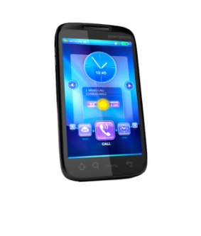
Supplemental DownLink (SDL)
1452-1492 MHz: impact assessment for better harmonisation
Growing assymetry in broadband networks
Technological solution developed in 3GPP and spectrum made available by ECC
1452-1492 MHz (Supplemental Downlink)
FDD Paired (Downlink)
FDD Paired (Uplink)
F1’
F2’
F1
F2
F1
F2
Downlink
Uplink

Slide 13
New Frequency Bands for Wireless Broadband ?
700 MHz band : A second digital dividend
5 GHz : additional bands for WiFi (5350-5470 MHz & 5725-5925 MHz) ?
Avoiding WiFi becoming the « bottleneck » of broadband access. Contiguous band (5150-5925 MHz) for wider capacity
Compatibility studies with Earth Exploration, Fixed Satellite, Radars, Intelligent Transport Systems …
L band (1350-1518 MHz) : Several candidate bands for WRC-15
2300-2400 MHz under Licensed Shared Access
Improving harmonisation in the band 3400-3800 MHz
…

Slide 14
Long term UHF vision – what, how and when ?
Task Group TG6 (Chair Jaime Afonso (POR)) created for taking more strategic and proactive approach to long term for UHF broadcasting band, (focusing on 470-694 MHz)
Some technical focus but not only:
How to best use broadcast (high power/high tower) and mobile dense networks ?
Which services for which terminals through which networks ?
Cross-border coordination between different networks ? Coexistence possibilities ?
Produce ECC Report mid-2014 ”to identify and analyse possible scenarios for the development of the band in the long term”

Slide 15
MANY THANKS !

